Slide 1
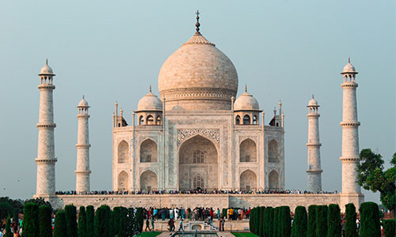

Travel Booking

Slide 2

Introduction
Full Stack Application using JAVA- Travel Booking
Welcome to our travel booking web page, where you can plan and book your next trip with ease. Our platform offers a wide range of travel options, including flights, hotels, rental cars, tours, and activities, all in one place. Whether you are planning a family vacation, a romantic getaway, or a business trip, we have everything you need to make your travel experience seamless and enjoyable.

Slide 3
Technology Used
Spring Boot Framework
MySQL
Angular CLI
Full Stack Application
Hibernate
Node JS
JPA

Slide 4
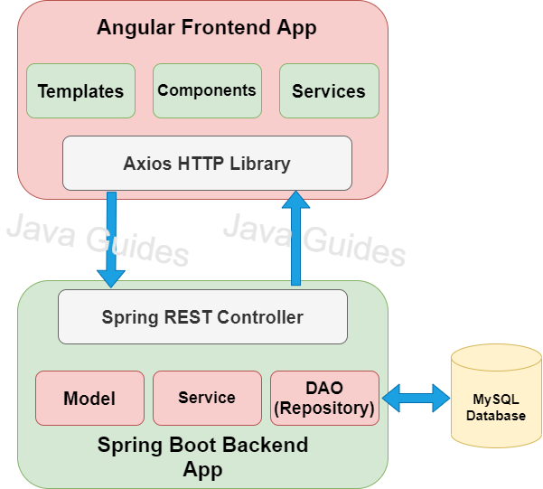
The Architecture of Angular, Spring & Database

Slide 5
Operations
Login
Booking
Journey
View
Packages
Tickets

Slide 6
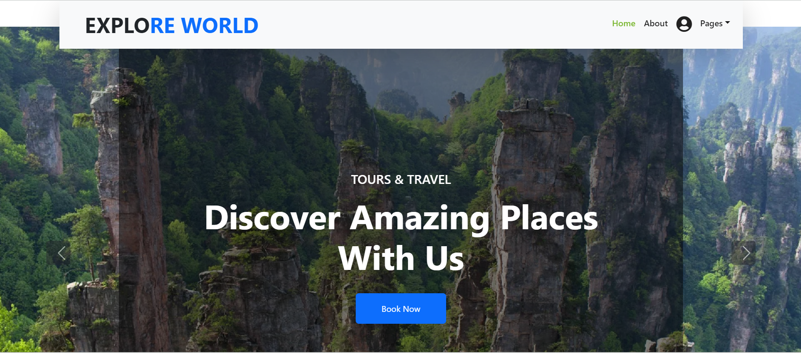
Home Tab

Slide 7
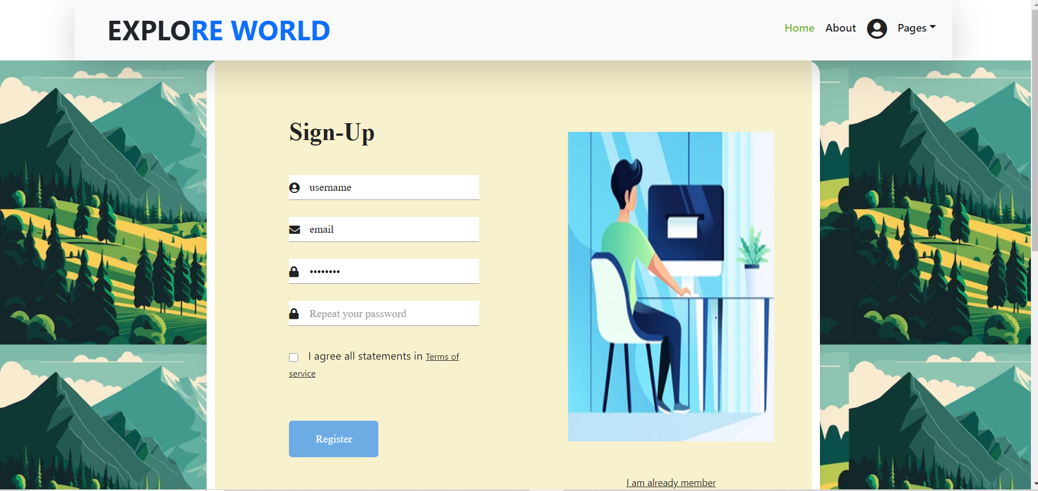
Login

Slide 8
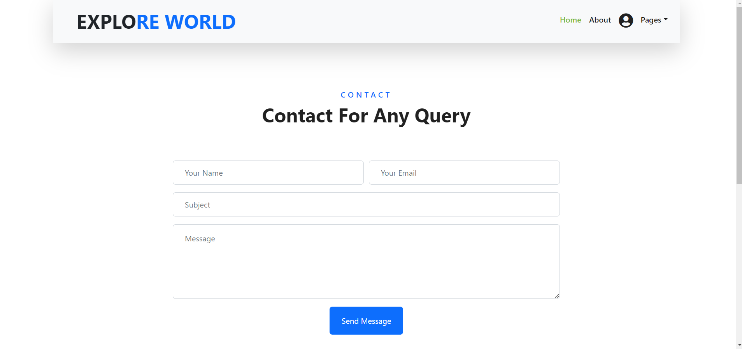
Contact

Slide 9
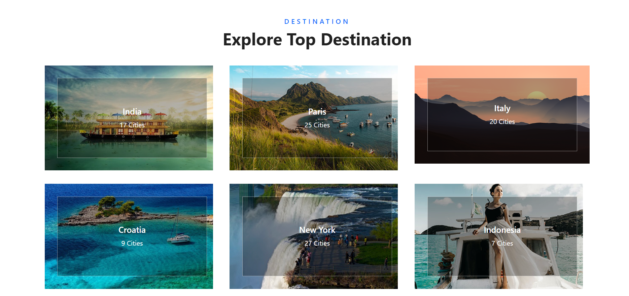
Destinations

Slide 10
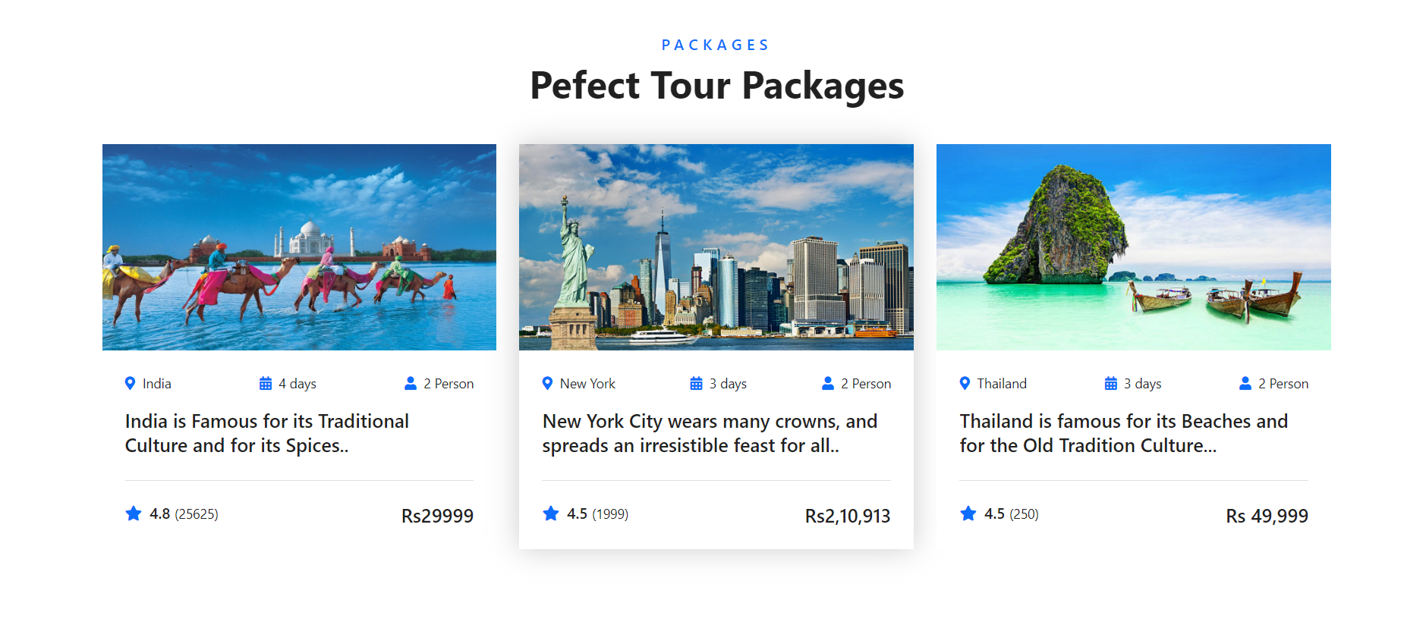
Packages

Slide 11
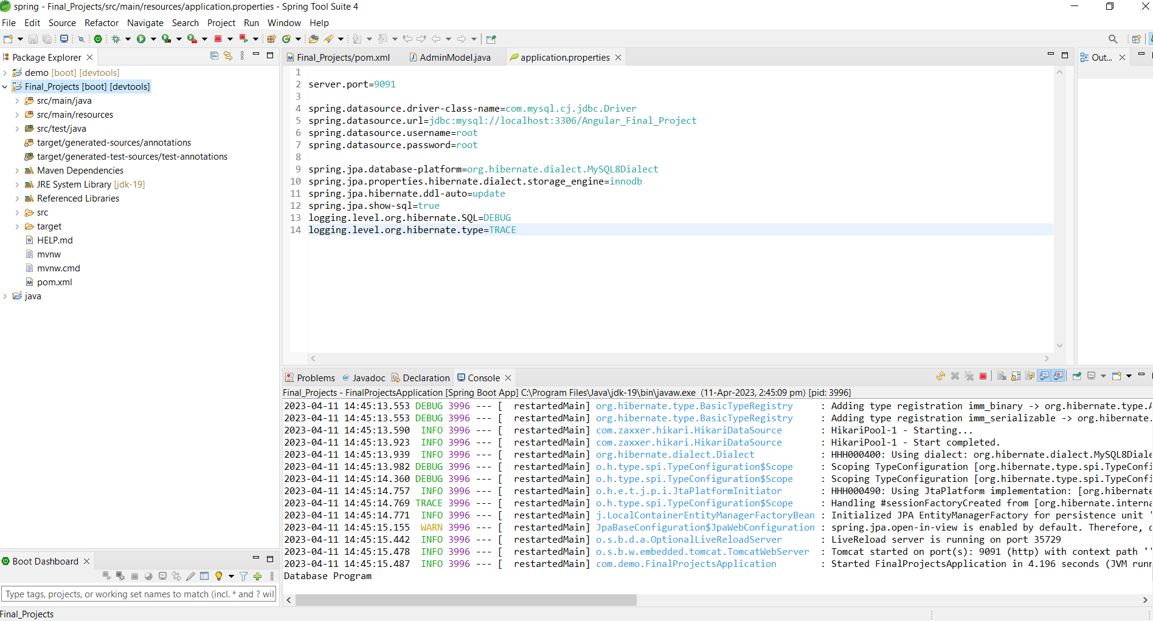
Spring Boot Application

Slide 12
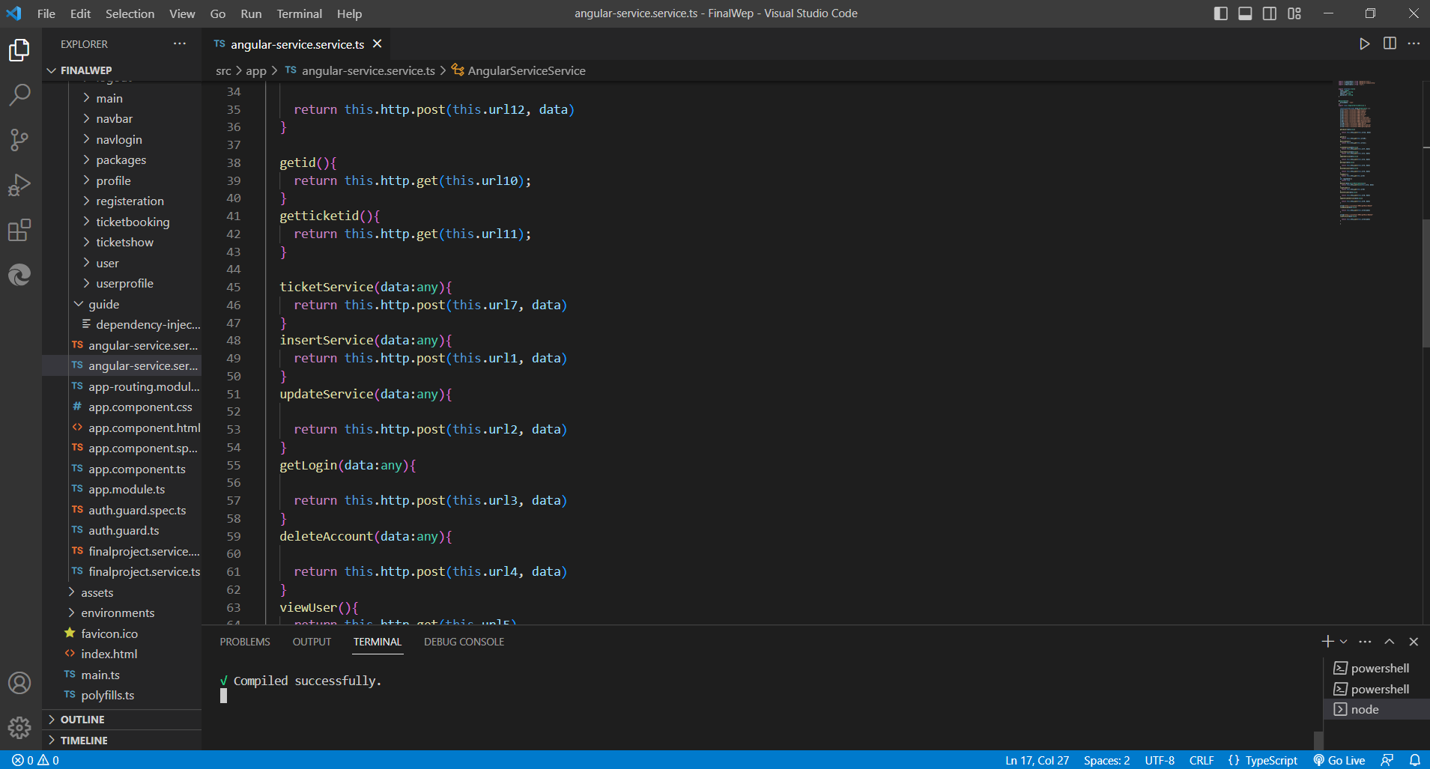
Frontend-Angular JS

Slide 13
Future Scope
To smoothen the process.
The system generate types of information that can be used for various purposes.

Slide 14
THANK YOU

